Slide 1
Web Technologies
Laravel Sessions
Laravel Cookies

Slide 2
Summary of Today’s Lecture
Laravel Sessions
Introduction to Laravel Session
Storing Session Data
Accessing Session Data
Destroying a Session
Laravel Cookies
Introduction to Laravel Cookies
Create Cookie
Accessing Cookie Value
Delete a Cookie

Slide 3
Laravel Sessions
Since HTTP driven applications are stateless, sessions provide a way to store information about the user across multiple requests.
A single website normally contains multiple webpages which have a shared information among them,
How to share login information between these pages keeping in view that only an authenticated user can access a certain page?
Session variables solve this problem by storing user information to be used across multiple pages (e.g. login details etc).
Session variables hold information about one single user and are available to all pages in one application.
Sessions have the capacity to store relatively large data compared to cookies.

Slide 4
Where is session data stored?
The session configuration file is stored at config/session.php.
The session driver configuration option defines where session data will be stored for each request. Laravel ships with several great drivers out of the box:
file - sessions are stored in storage/framework/sessions.
cookie - sessions are stored in secure, encrypted cookies.
database - sessions are stored in a relational database.
memcached / redis - sessions are stored in one of these fast, cache based stores.
By default, Laravel is configured to use the file session driver, which will work well for many applications. In file session driver, the session data is stored in storage/framework/sessions.

Slide 5
Storing Session Data
To store data in the session, you will typically use put method or the global session helper:
// Via the global "session" helper...
session(['key' => 'value']);
//Via put method in Session façade
Session::put('key', 'value');
Suppose, we want to save data in the session when password of the user matches for authentication. Then we have to place following code in the match()method in the UserController class.
if (($tablepass->password) == $pass){
Session::put('user', $uname);
//session()->put('user',$uname);
return redirect('home');
}

Slide 6
Retrieving Session Data
The primary way of working with session data in Larave is the global session helper.
// Via the global "session" helper...
$value = session('key');
//Via put method in Session façade
Session::get('key');

Slide 7
Deleting Session Data
When user clicks "Logout", or "Sign Off", you would usually want to destroy all the login data so nobody could have access to it anymore.
The forget method will remove a piece of data from the session. If you would like to remove all data from the session, you may use the flush method.
//Via forget method in Session façade
Session::forget('user');
Suppose, we want to delete data in the session when user logs out of the account. Then we have to place following code in the logout()method in the UserController class.
if (Session::has('user')){
//session()->forget('user');
//Session::forget('user');
Session::flush();
}

Slide 8
Laravel Cookies
A cookie is a small text file that lets you store a small amount of data on the user's computer.
It is sent by a server to a browser, and then sent back by the browser on future page requests.
Each time the same computer requests a page with a browser, it will send the cookie too. With Laravel, you can both create and retrieve cookie values.
Cookies may be used for:
maintaining user preferences,
record the user's browsing activity,
remembering data over a longer period etc.

Slide 9
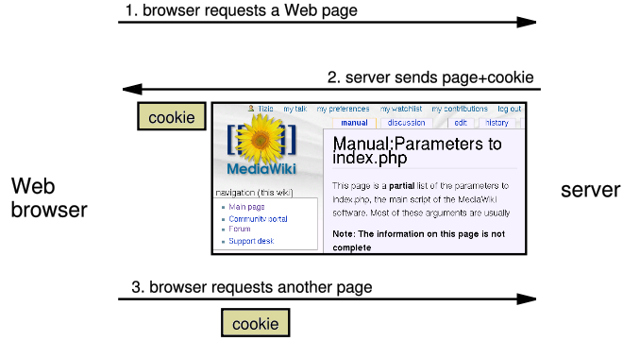
How Cookies are sent
When the browser requests a Web page,
The server may send back a cookie(s) with it along with the Web page.
If your server has previously sent any cookies to the browser, the browser will send them back on subsequent requests.

Slide 10
Setting a Cookie in Laravel
You can attach cookie to redirect responses. Redirect responses are instances of the Illuminate\Http\RedirectResponse class, and contain the proper headers needed to redirect the user to another URL.
You may pass the name, value, and the number of minutes the cookie should be considered valid to this method.
return redirect('home')->cookie('name', $fishname, 10);

Slide 11
Cookies & Encryption
By default, all cookies generated by Laravel are encrypted and signed so that they can't be modified or read by the client.
If you would like to disable encryption for a subset of cookies generated by your application, you may use the $except property of the App\Http\Middleware\EncryptCookies middleware, which is located in the app/Http/Middleware directory:
/**
* The names of the cookies that should not be encrypted.
*
* @var array
*/
protected $except = [
'cookie_name',
];

Slide 12
Retrieving a Cookie in Laravel
We may also use Cookie façade interface for accessing cookie values in controller or views.
if (Cookie::has('weight')){
//$name = Request::cookie('name');
$name = Cookie::get('weight');
echo $name;
}

Slide 13
Removing a cookie in Laravel
You may use the Cookie facade's expire method to expire a cookie:
Cookie::expire('name');
Suppose, we want to delete cookie when the user logs outs of the Web Application.
if (Session::has('user')){
if (Cookie::has('name')){
Cookie::expire('name');
}
Session::flush();
}

Slide 14
Cookie vs Session
A cookie data is stored on the client side.
Cookie is preferred when you need to store long-term information/values, such as user's shopping preferences.
Cookies has a size limit.
Cookies can be accessed easily. So it is less secure.
A session’s data is stored on the server.
Session is preferred when you need to store short-term information/values such as user’s login status.
Session does not have size limit.
Sessions variables cannot be accessed easily. So it is more secure.

Slide 15
Summary of Today’s Lecture
Laravel Sessions
Introduction to Laravel Session
Storing Session Data
Accessing Session Data
Destroying a Session
Laravel Cookies
Introduction to Laravel Cookies
Create Cookie
Accessing Cookie Value
Delete a Cookie

